Slide 1
The use of PSA testing in diagnosing prostate cancer
Ross Lawrenson
Notes:
University of Waikato – new University rapidly rising up the rankings
Manages large programmes across many different fields (environment, education, IT etc)

Slide 2
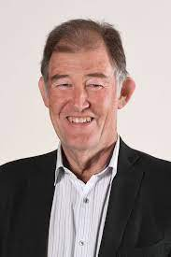
About me
First job in 1977 was as a urology house surgeon
10 years as a GP
Public health training
Chaired NSAC for 9 years
Midland Prostate Cancer study – HRC
Member of the Prostate Cancer Taskforce

Slide 3
Why is prostate cancer important?
4000 NZ men each year are diagnosed with prostate cancer
75% have localised disease with excellent prognosis
560 men will die each year from metastatic prostate cancer
There are 25,000 men in New Zealand living with diagnosed prostate cancer

Slide 4
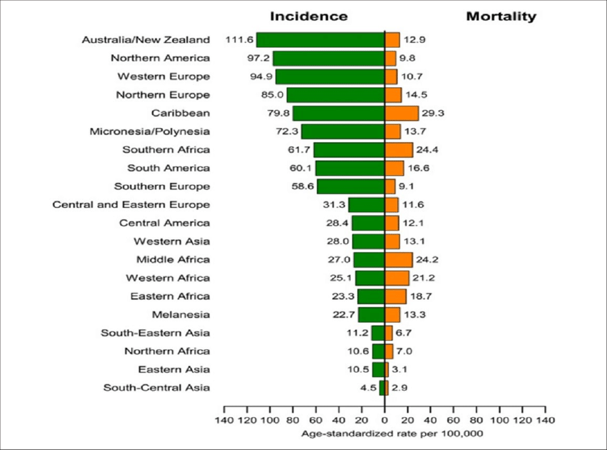
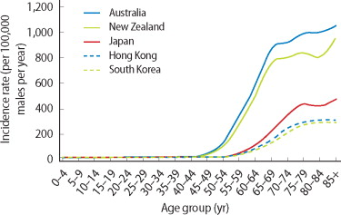
International comparison

Slide 5
Testing vs screening
NZ GPs do almost 500,000 PSA tests per year
80% of these are in asymptomatic men and can be considered “opportunistic” screening
Most NZ GPs think screening for prostate cancer is worthwhile (while UK GPs for instance do very little screening)

Slide 6
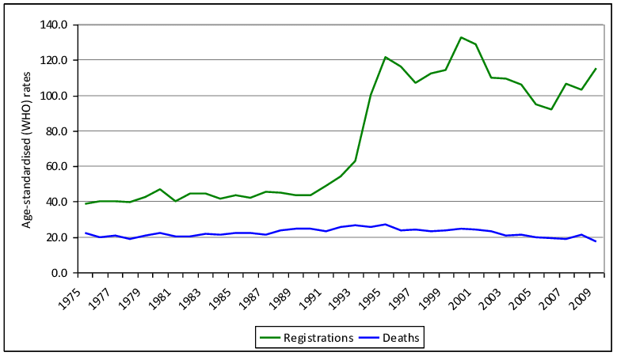
Incidence in New Zealand

Slide 7
What is prostate cancer?
What are the early signs and symptoms of prostate cancer/does it always have early symptoms?
How does it spread?
How is it diagnosed
How is it treated?

Slide 8
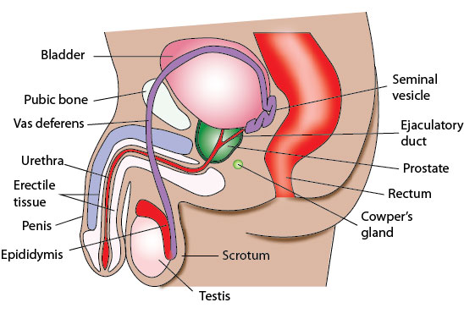
What are the early signs and symptoms of prostate cancer?

Slide 9
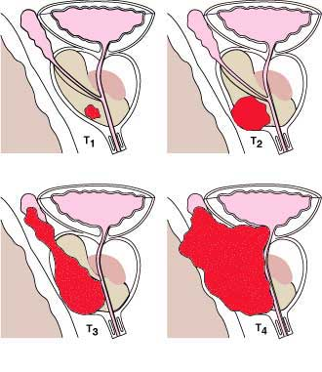
How does it spread?
American Joint Committee on Cancer. American Joint Committee on Cancer. Cancer Staging: What You Need to Know? Chicago, IL: American Joint Committee on Cancer; 2010.
Notes:
1.4.3.1.

Slide 10
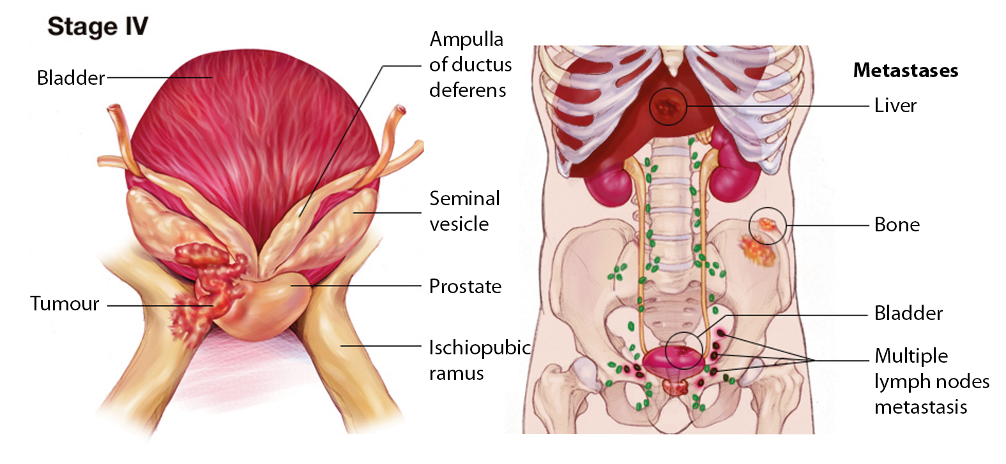
T4 Prostate Cancer – regional/distant spread
Notes:
Stage IV cancers have spread to lymph nodes or other parts of the body such as the bladder, rectum, bones, liver or lungs. Metastatic prostate cancer is often found in the bones. Gleason scores range from 2 to 10.

Slide 11
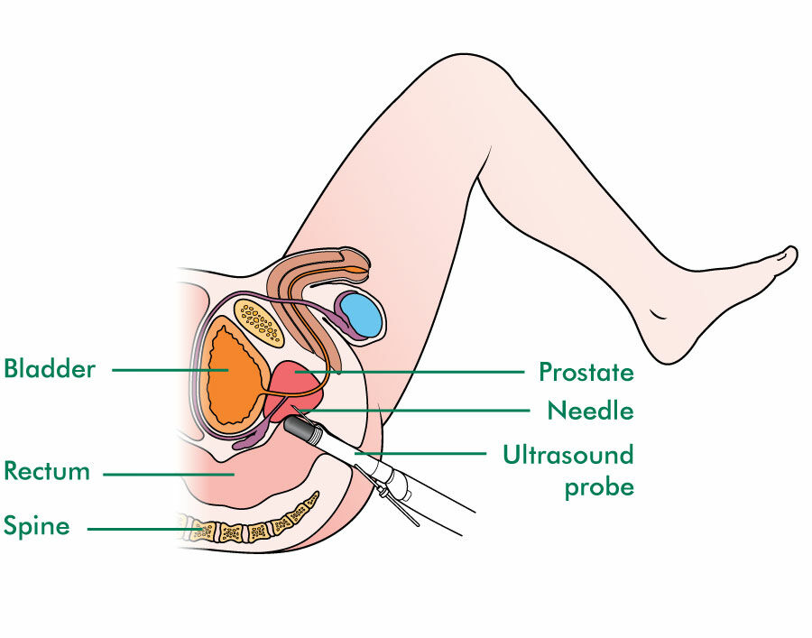
How is it diagnosed? TRUS biopsy

Slide 12
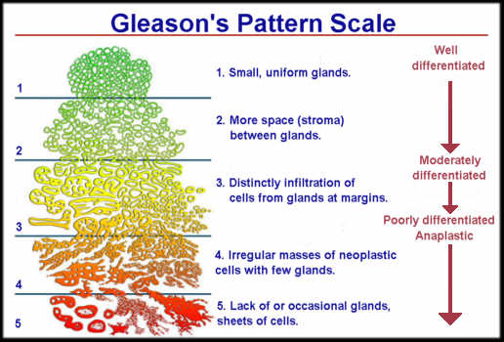

Slide 13
After a raised PSA
1082 men
with elevated
PSA in 2010
467 (43%)
referred to specialist
165
no biopsy
302 (65%)
had a biopsy
139
had negative biopsy
165 (54%)
had positive biopsy=
= prostate cancer
615
not referred
22 men referred with normal PSA; 14 had a biopsy, 7 had positive biopsy
Notes:
The estimated proportion of men aged 40+ years not residing in MUA in the Midland Cancer Network region is 49.3%. Māori men aged 40+ yrs in Midland:

Slide 14
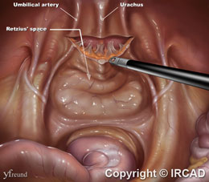
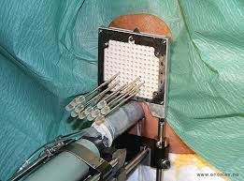
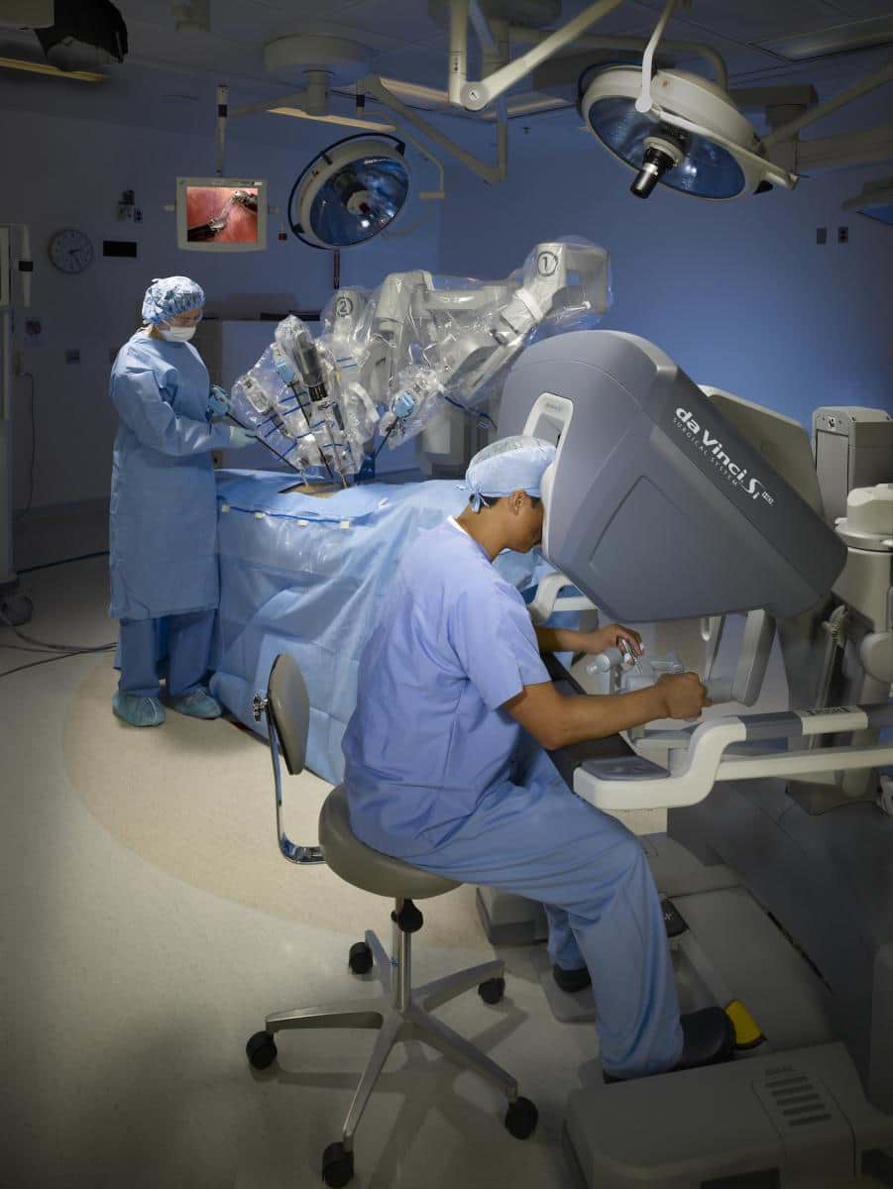
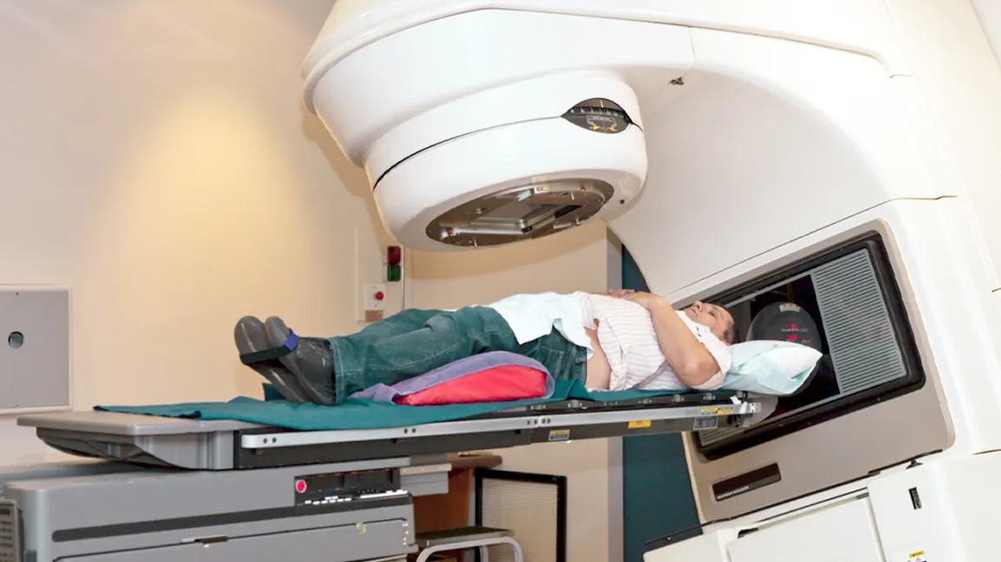
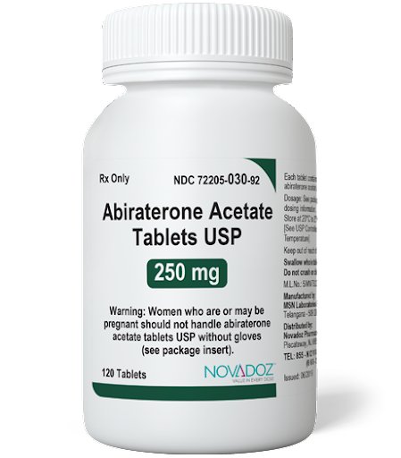
How is it treated?

Slide 15
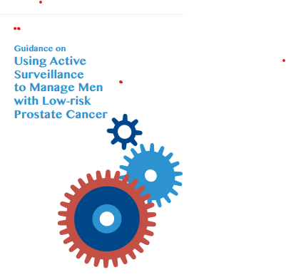
Active surveillance
Active surveillance is a management option for men with localised, low-risk prostate cancer.
Active surveillance aims to avoid or delay the need for curative treatment, thereby reducing the potential for treatment-related harms.
Active surveillance involves actively monitoring the prostate cancer with regular prostate-specific antigen (PSA) tests, digital rectal examinations (DREs), prostate biopsies and MRIs.
If progression is confirmed, the man then has the option to undergo curative treatment

Slide 16
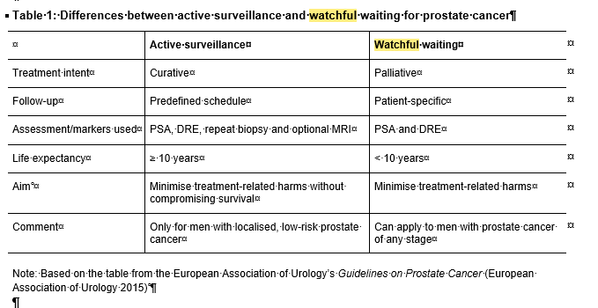
Watchful waiting

Slide 17
 | AS | WW | EXBT | HDR | LDR | RP | TNA | Grand Total
Ethnicity
Maori | 10 (10.2%) | 14 (14.3%) | 22 (22.4%) | 10 (10.2%) | 2 (2.0%) | 33 (33.7%) | 7 (7.1%) | 98 (100.0%)
Non-Maori | 25 (8.1%) | 37 (12.0%) | 38 (12.3%) | 3 (1.0%) | 20 (6.5%) | 152 (49.2%) | 34 (11.0%) | 309 (100.0%)
Age
≤49 | 0 (0.0%) | 0 (0.0%) | 0 (0.0%) | 1 (9.1%) | 1 (9.1%) | 9 (81.8%) | 0 (0.0%) | 11 (100.0%)
50-59 | 10 (10.3%) | 2 (2.1%) | 9 (9.3%) | 3 (3.1%) | 8 (8.2%) | 54 (55.7%) | 11 (11.3%) | 97 (100.0%)
60-69 | 21 (10.6%) | 5 (2.5%) | 38 (19.2%) | 7 (3.5%) | 7 (3.5%) | 102 (51.5%) | 18 (9.1%) | 198 (100.0%)
≥70 | 4 (4.0%) | 44 (43.6%) | 13 (12.9%) | 2 (2.0%) | 6 (5.9%) | 20 (19.8%) | 12 (11.9%) | 101 (100.0%)
Grand Total | 35 | 51 | 60 | 13 | 22 | 185 | 41 | 407
AS: active surveillance; WW: watchful waiting; EXBT: external beam radiotherapy; HDR: high dose brachytherapy; LDR: low dose brachytherapy; RP: radical prostatectomy; TNA: treatment information not available
Notes:
17

Slide 18
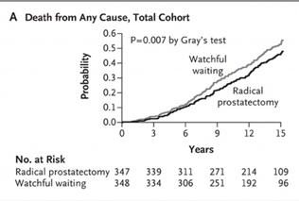
Prostatectomy vs watchful waiting
Randomised trial started in the 1990s of prostatectomy vs no active treatment

Slide 19
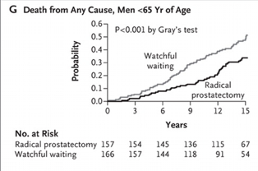
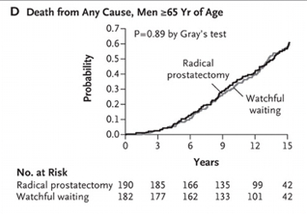
Outcomes in older men

Slide 20
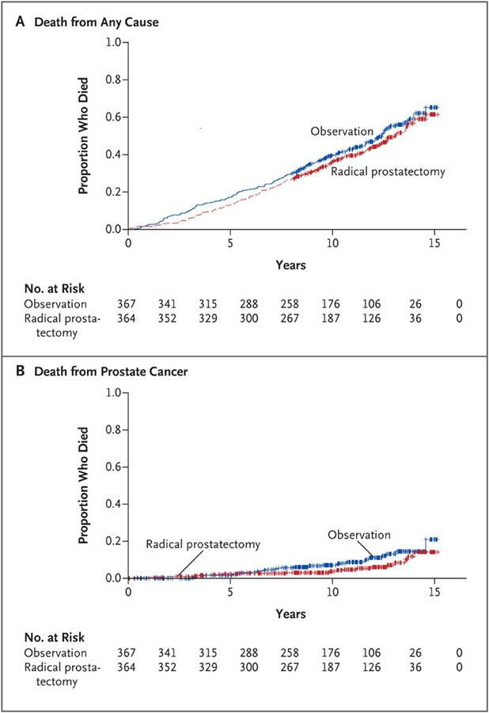
PIVOT study
Trial of watchful waiting vs prostatectomy in localised cancer
Wilt TJ, Brawer MK, Jones KM, et al. Radical prostatectomy versus observation for localized prostate cancer. N Engl J Med 2012;367:203-21

Slide 21
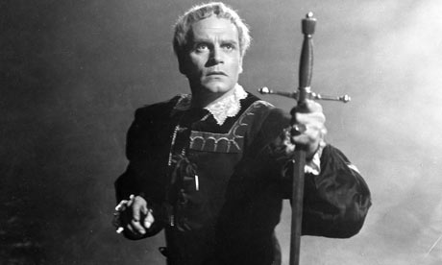
To screen or not to screen

Slide 22
What is screening?
Screening is the practice of investigating apparently healthy individuals with the object of detecting unrecognised disease or its precursors so that measures can be taken to prevent or delay the development of disease or to improve the prognosis.

Slide 23

Screening Criteria
The condition is a suitable candidate for screening
There is a suitable test
There is an effective and accessible treatment or intervention for the condition
There is high quality evidence, ideally from randomised controlled trials, that a screening programme is effective in reducing morbidity or mortality
The potential benefit should outweigh the potential harm
The health care system will be capable of supporting all necessary elements of the screening pathway
There is consideration of social and ethical issues
There is consideration of cost-benefit
Notes:
In 2003, the National Health Committee issued criteria to assess screening programmes:
The condition is a suitable candidate from screening
There is a suitable test
There is an effective and accessible treatment or intervention for the condition identified through early detection
There is high quality evidence, ideally from randomised controlled trials, that a screening programme is effective in reducing morbidity or mortality
The potential benefit should outweigh the potential harm
The health care system will be capable of supporting all necessary elements of the screening pathway, including diagnosis, follow-up and programme evaluation
There is consideration of social and ethical issues
There is consideration of cost-benefit issues
NSAC is currently in discussions with the National Health Committee over the possible refreshing of the criteria to ensure their continued applicability to future screening activity.

Slide 24
Suitable candidate for screening
Important health problem (i.e. severity and frequency)
Natural history should be understood
Recognised latent phase

Slide 25
There is a suitable test
Prostate specific antigen (PSA)> glycoprotein produced from
prostate gland
PSA rises with:
Benign prostatic enlargement
Prostatitis or sub-clinical prostate inflammation
Following digital rectal exam (DRE)
Cyclists!
Prostate cancer (but not always)
GPs use it to diagnose men with prostate symptoms, monitoring men with cancer and for screening asymptomatic men for prostate cancer

Slide 26
What is the PSA test?
Will a PSA test pick up prostate cancer?
What is a ‘normal’ result?
What is an abnormal PSA test and what level should I be referred?
What are the limitations of the PSA test?
How often should I have a PSA test?

Slide 27
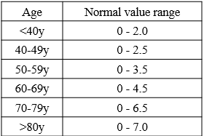
Prostate Cancer Management and Referral Guidance

Slide 28
What is the PSA test?
Will a PSA test pick up prostate cancer?
What is a ‘normal’ result?
What is an abnormal PSA test and what level should I be referred?
What are the limitations of the PSA test?
How often should I have a PSA test?

Slide 29
Should a man have a digital rectal exam at the same time as a screening PSA?
Some cancers occur without a raised PSA but can be picked up on DRE
Some men have a raised PSA due to an enlarged but non-cancerous prostate gland

Slide 30
DRE in the Midland study
7/172 (4%) cases identified had a normal PSA
Most men (73%) said they had received a DRE.
Māori (71%) and non-Māori men (73%) were just as likely to receive a DRE
Men aged 60–69 years (86%) were most likely to receive a DRE by their GP.

Slide 31

There is high quality evidence - ideally from randomised controlled trials
ERSPC
PLCO
Göteborg

Slide 32
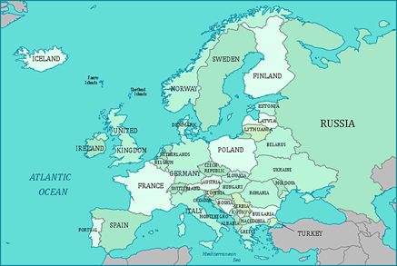
European Randomized Study of Screening for Prostate Cancer (ERSPC)
Included 182,000 men recruited over 10 years from 7 different European countries
Men aged 55 to 75 years
Screened men every 4 years
Considered positive if test greater than 2.4 ng/ml

Slide 33
ERSPC
The trial analysed men from ages 55 to 69 years
Absolute risk difference between the screening and control groups of 0.71 prostate cancer deaths per 1000 men.
1410 men would have to be screened 1.7 times over 9 years (number needed to screen),
48 men would need to be treated (number needed to treat) to prevent one prostate cancer death.
There was no benefit in all cause mortality

Slide 34
ERSPC
13 years of follow up published Lancet 2014
Absolute risk difference between the screening and control groups of 1.28 prostate cancer deaths per 1000 men.
781 men would have to be screened over 13 years (number needed to screen),
27 men would need to be diagnosed (number needed to treat) to prevent one prostate cancer death.
Despite showing a clear prostate cancer mortality reduction, the findings are not sufficient to justify population-based screening.

Slide 35
ERSPC

Slide 36
PLCO
180,000 men and women recruited in US for a study of prostate, lung, colorectal and ovarian cancer
76,693 men randomised
Aged 55 to 75 years
Screened men every year
2820 cancers in screening group, 2323 in control
50 deaths from PC in screening group and 44 in control group

Slide 37
PLCO
Smaller sample size
Older patient group
Significant contamination in control group

Slide 38
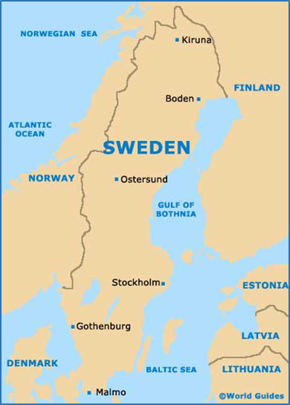
Göteborg study (2010)
20,000 men aged 50-64 years.
PSA cut-off 2.4 ng/mL
Participation rate in at least one screening round was 76% (n=7578) and a total of 29315 PSA tests were performed.
A total of 4693 positive PSA results were recorded.
33% of the participants (n= 2469) received at least one positive result and 93% of these (n=2298) had a biopsy

Slide 39
Göteborg study (2010)
After 14 years of follow-up, within a core age group of 50 to 64 years, 44 and 78 prostate cancer deaths were observed in the screening group and control groups respectively. The unadjusted rate ratio for death from prostate cancer in the screening group was 0.56 (95% CI, 0.39-0.82 p=0.002).
This corresponds with a significant absolute risk difference between groups of four deaths per 1000 men.
The incidence of prostate cancer was almost 60% greater in the screened group (see table) .
The all cause mortality in the two groups was 1982 in the control group and 1981 in the screened group.

Slide 40
Göteborg study
 | Control Group | Screened Group
Number with prostate cancer | 718 | 1138
Number of prostate cancer deaths | 78 | 44
Number with prostate cancer who died of unrelated causes | 54 | 109

Slide 41
Other considerations
The potential benefit should outweigh the potential harm
The health care system will be capable of supporting all necessary elements of the screening pathway
There is consideration of social and ethical issues
There is consideration of cost-benefit

Slide 42
Harm from screening
Worry from positive test
Harm from biopsy
Harm of treatment

Slide 43
Harm of treatment (“Let sleeping dogs lie”)

Slide 44
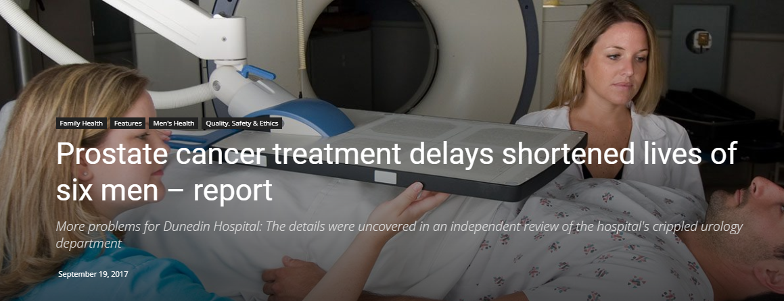
Can the health care system cope?

Slide 45
The cost-effectiveness of prostate cancer screening
Author, year | Country | Perspective | Screening strategy | Results
A. Shteynshlyuger[2], 2011 | USA | Societal perspective | Screen men aged 55-69 years at an interval of 4 years: ERSPC screening protocol | US$262,758 per life-year saved
A. J. Martin[3], 2013 | Australia | Perspective of the health care system | Screen men aged 50 years at an interval of 4 years | AU$291,817 per QALY for men with average risk; AU$110,726 per QALY for men with two times the average risk; AU$30,572 per QALY for men with five times the average risk
R. Pataky [4], 2014 | Canada | Perspective of health system | The most cost-effective strategy: A single screen at age 60 years, followed by a screen at age 65 years for men with PSA above the median | CAN$340,300 per QALY
Lao, C., Brown, C., Rouse, P., Edlin, R. & Lawrenson, R. Economic evaluation of prostate cancer screening: A systematic review. Future Oncology 11, 467-477 (2015).

Slide 46

What are the social and ethical issues?
Does PCa screening stand on principles of non-maleficence (first do no harm) and beneficence (preventing harm)?
Does PCa screening stand on the ethical principle of justice (cost effectiveness)?
Does PCa screening respect patient autonomy?
Mishra SC. Journal of Medical Ethics.
A discussion on controversies and ethical dilemmas in prostate cancer screening
http://orcid.org/0000-0001-6086-6541

Slide 47
Other issues
A family history of prostate cancer
Prostate cancer in Māori and Pacific men
GP attitudes to prostate cancer screening
What age should screening be done?

Slide 48

Is a family history important?
Prostate cancer seems to run in some families, which suggests that in some cases there may be an inherited or genetic factor.
Having a father or brother with prostate cancer more than doubles a man’s risk of developing this disease.
The risk is much higher for men with several affected relatives, particularly if their relatives were young when the cancer was found.

Slide 49
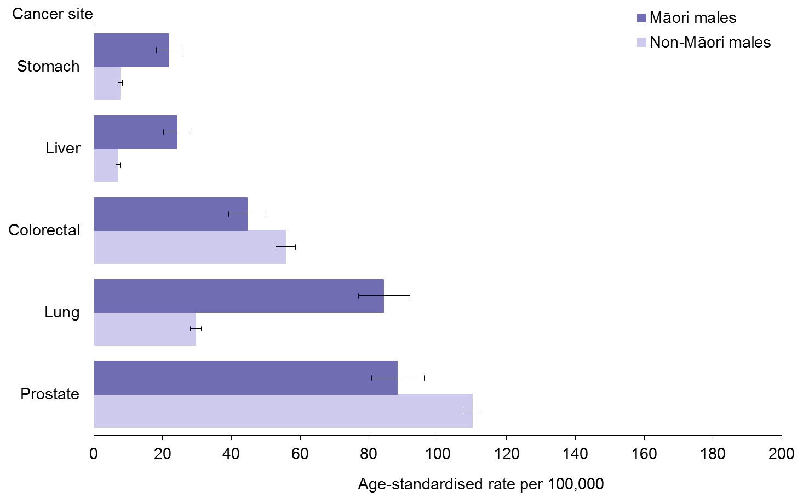
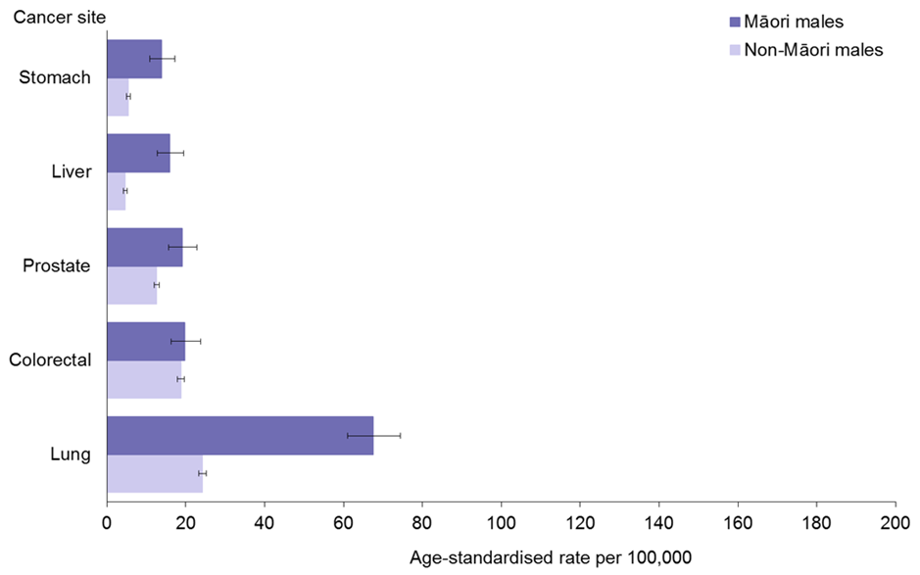
I was told Māori don’t get prostate cancer as often
Māori men are less likely to be tested/screened
Māori are less likely to be referred from GP, less likely to have a biopsy, but more likely to have a positive test
Māori men diagnosed with PCa have 1.8 times mortality of non-Māori with prostate cancer
Māori men with localised disease are twice as likely to be treated with radiotherapy

Slide 50
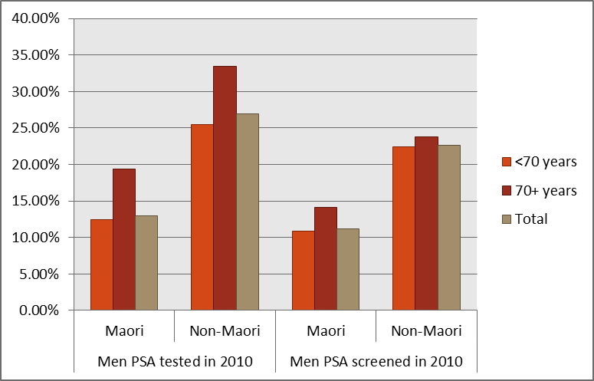
Do Māori get tested/screened as often?

Slide 51
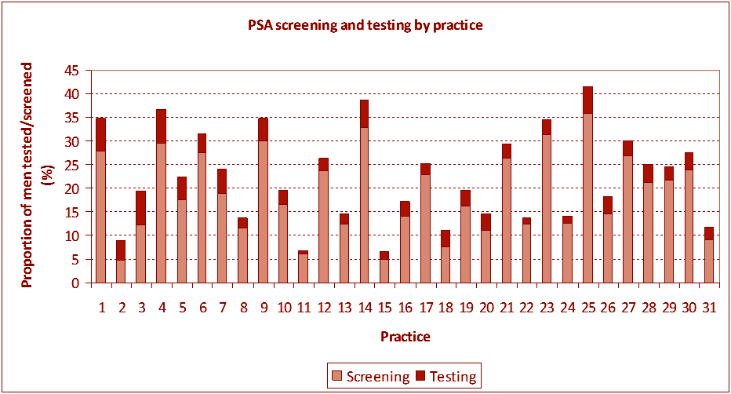
PSA testing by general practitioners

Slide 52
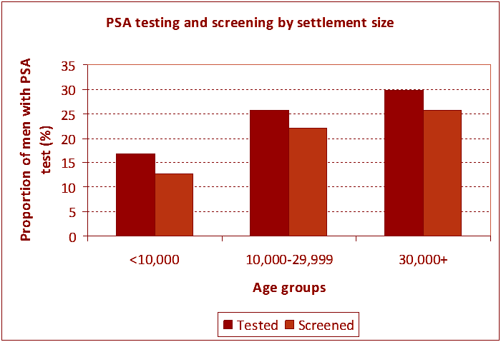
Does being a rural patient matter?

Slide 53
What age should I start getting PSA tests? Should I get these done till I die?
Probably no point if over 70 years
Probably not much point unless you are guaranteed to live >10 years
Probably not much point if you are not prepared to risk treatment
Probably not worth getting one between 40 and 50 unless you have a family history of prostate cancer
Possibly worth it if you are between 50 and 70 years but need to discuss with your GP or at least someone who can explain your personal risk and risks of testing.
Notes:
Answer to question 5.What age should I start getting PSA tests? Should I get these done till I die?(click) There is no evidence to support screening after the age of 70 years. Probably not much point unless you are guaranteed to live more than 11 years. Probably not much point if you are not prepared to risk treatment . Certainly we know there are considerable complication associated with treatment. This why the urologists wont normally GPs as we are sure you are aware vary in their approach biopsy if you don’t have symptoms and your prostate feels normal. Probably not worth getting one between 40 and 50 unless you have a family history of prostate cancer. Possibly worth it if you are between 50 and 70 years but need to discuss with your GP or at least someone who can explain individualized risk and benefits and risks of testing.

Slide 54
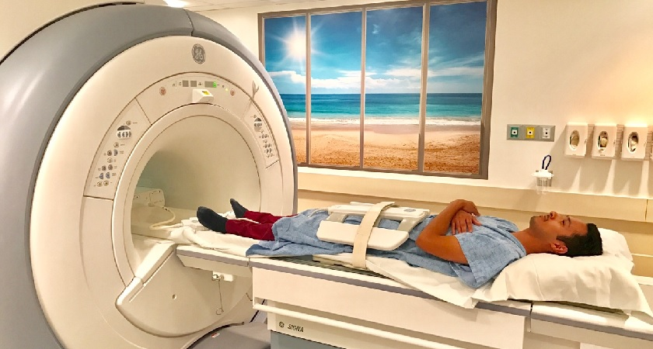
What advances might we see in prostate cancer early diagnosis in the future?
Better diagnosis
Better treatment

Slide 55
Summary
Some evidence of benefit of screening in men aged 50-69
Needs to be balanced with potential for over diagnosis and over treatment
Much of the screening currently is in men aged over 70 where there is the potential for harm, but no evidence of increased life
New technologies may change the current advice
Advice is that having a PSA test should be left to the patient to make an informed choice.

